Slide 1

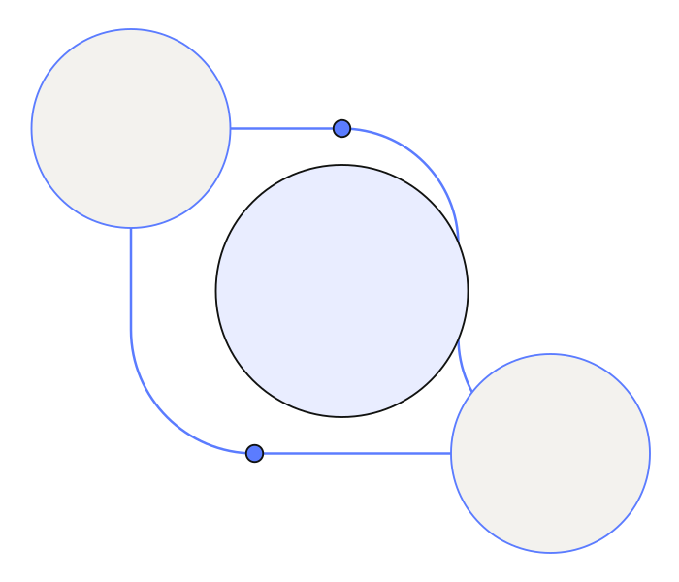
Mandate
The right connection.
A clearer path from business information to lender conversations.
PRIVATE CREDIT, MADE CLEARER FOR ADVISERS
Notes:
Opening hook: Advisers often start with information spread across accounts, deal notes and lender criteria. Mandate brings those pieces together so the funding story is easier to review and explain. Then introduce the live demo.

Slide 2
OPEN THE LIVE MANDATE DEMO ↗
Why now: private credit
New Zealand businesses face changing funding options.
2023–24
A broader set of lenders
Private credit is attracting new capital and can offer tailored structures. Each fund still brings its own criteria.
SME lending declined, while shorter, smaller-scale finance became more common.
OECD Economic Surveys: New Zealand 2026
Advisers need a clear way to compare each deal with lender requirements.
LIVE DEMO
Open the site for the product walkthrough, then return here for the close.
mandate-ollie-software.vercel.app
Notes:
Why now: OECD's 2026 New Zealand survey says SME lending declined sharply in 2023 and 2024 and that shorter, smaller-scale finance became more common. Chambers' 2026 New Zealand private-credit guide describes additional capital, tailored structures and a market that is still developing. The opportunity for Mandate is helping advisers review the fit and prepare a clear, checked funding story. Demo link: https://mandate-ollie-software.vercel.app/
Sources:
OECD, OECD Economic Surveys: New Zealand 2026, https://www.oecd.org/en/publications/oecd-economic-surveys-new-zealand-2026_3ec5de98-en/full-report/unlocking-capital-markets-to-drive-growth_d1f7a7f7.html
Chambers and Partners, Private Credit 2026: New Zealand, https://practiceguides.chambers.com/practice-guides/private-credit-2026/new-zealand

Slide 3
That’s how we
Mandate.
Next steps
01 Validate lender criteria with adviser partners
02 Test the workflow on more deal types
03 Refine lender-ready summaries and reports
Thank you
Notes:
Close: That's how we Mandate. Invite feedback from advisers and lenders on which checks, evidence and report formats would make this most useful in practice. Suggested next steps on screen are proposed validation work, not completed commitments.

